Slide 1
What is Sociology?
Perrin Definition: Sociology is the scientific study of human societies and of human behavior in social settings.
Stark Definition: The scientific study of the patterns and processes of human social relations

Slide 2
The Sociological Perspective
**The sociological perspective - opens a window onto unfamiliar worlds, and offers a fresh look at familiar worlds.
It enables one to gain a new vision of social life.
It examines how group membership influences behavior.

Slide 3
The Sociological Perspective
This perspective allows us to examine society - a group of people who share a culture and a territory.
Social location allows sociologists to understand behavior by examining the location in which they belong.
Our view of the world is a result of our exposure to different groups.
*In essence, the way society and group life influences people’s lives is the root of the sociological perspective.

Slide 4
The Origins of Sociology
Sociology is a very new discipline.
*It emerged during the nineteenth century.
*It grew out of upheaval during the Industrial Revolution.
The American and French Revolutions encouraged new thought.
Scientists began applying the scientific method to real world problems.

Slide 5
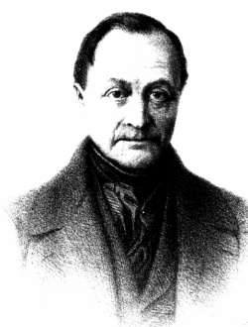
Auguste Comte- 1798-1857 “The Father of Sociology”
Positivism proposed the idea of applying the scientific method to social life.
Comte called this new science “sociology” - the study of society.
His aim for sociology was to reform society and make it a better place to live.
Comte believed we must observe society in order to uncover it’s fundamental laws.

Slide 6
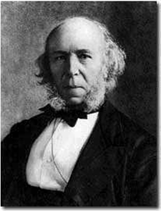
Herbert Spencer “Social Darwinism”
Spencer disagreed with Comte that reform should be the goal.
Spencer believed no one should intervene in the evolution of society.
*Spencer’s theory is said to be more philosophical oriented rather than scientific
He stated that societies evolve from lower to higher forms.
Over time, societies improve.
The fittest members will produce an advanced society.

Slide 7
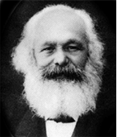
Karl Marx
*Marx stated that the engine of human history is class conflict.
He claimed there is a strong conflict between the bourgeoisie (those who own property) and the proletariat (those who are exploited).
The struggle between the classes would end only when the proletariat revolted.
The result would be a classless society.
Marxism is not communism.

Slide 8
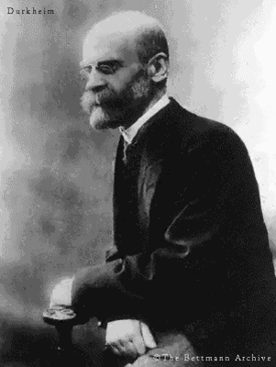
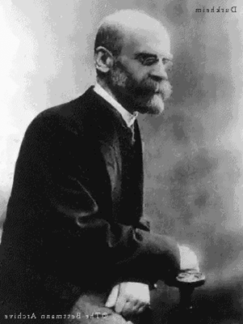
Emile Durkheim
Durkheim’s goal was to recognize sociology as an academic discipline.
He studied suicide rates and discovered social factors that contribute to suicide.
Durkheim believed that social forces affected peoples lives.
The key factor in suicide is social integration - the degree to which people are tied to their social group.
Those with weaker ties are most likely to commit suicide.
*One should always examine the social factors that impact people’s daily lives.

Slide 9
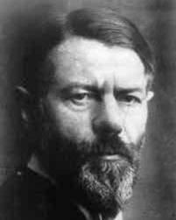
Max Weber
Weber did not believe economics was the force of social change.
Religion was the key.
The Protestant work ethic - the belief that working hard would please God.
Weber found that Protestant beliefs led to the growth of Capitalism.
Religion was the central factor in the rise of Capitalism.
*Invest more to acquire more. The spirit of capitalism.

Slide 10
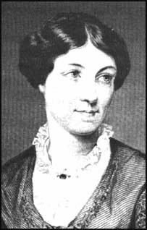
Sexism in Early Sociology
In the 1800’s, women were assigned the roles of wife and mother.
Higher education was reserved for men.
Those few who did attain degrees were often ignored.
Harriet Martineau - she had to hide her early research for fear that she would be seen as “masculine.”
*Primarily know for translating Comte’s ideas into English

Slide 11
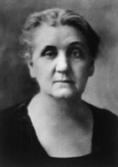
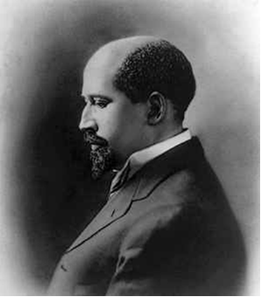
Sociology in North America
Jane Addams - she co-founded the Hull House in Chicago.
She opened the house for those who needed refuge: the poor, sick, and aged.
W.E.B. DuBois - he was the first African American to earn a doctorate at Harvard.
He helped to found the NAACP.
**Authored Soul of Black Folk, an analysis of the social and economic changes of black people in the thirty years following the Civil War.

Slide 12
Theoretical Perspectives in Sociology
Theory - a general statement about how some parts of the world fit together and how they work.
An explanation of how two or more facts are related to one another.
Sociologists use three main theories:
1) symbolic interactionism
2) functional analysis
3) conflict theory
**All three are essential to analyzing and human behavior

Slide 13
Symbolic Interactionism
Studies how people use language and symbols to establish meaning, develop views of the world, and communicate.
Our behaviors depend on the way we define ourselves and others.
Symbolic Interactionists study face to face interactions and relationships.

Slide 14
Functional Analysis
The central idea is that society is a whole unit, made up of interrelated parts that work together.
Like an organism, if society is to function smoothly, it’s parts must work together in harmony.
When all parts fulfill their functions, society is in a “normal” state.
*The functionalists states that in order to understand society one must look at both structure and function.

Slide 15
Conflict Theory
States that society is composed of groups engaged in fierce competition for scarce resources.
People in positions of authority try to enforce conformity, which, in turn, creates resentment and resistance.
The result is a constant struggle.

